Slide 1

HanDIYcraft
PROGRESS REPORT II
By
Nahathai Kaewtatib 542115018
Pimchanok Sripraphan 542115043

Slide 2
Agenda
Introduction
Progress report 2 work items
Software demo
Mistakes and problems
Progress 3 (Show pro) plan

Slide 3


Introduction

Slide 4

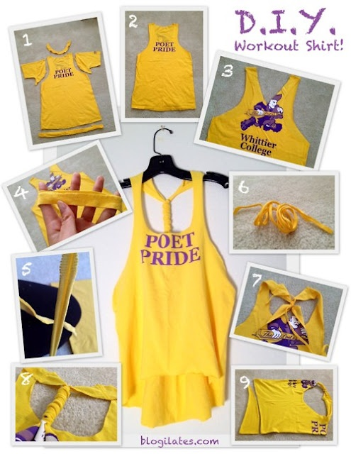

Introduction
DO
It
Yourself

Slide 5





Introduction

Slide 6


Introduction
Where?
material they want

Slide 7






Users
send messages
Explore shops
Explore tutorials
manage tutorials
Share to facebook
comment
Search blogger
send messages
manage
shops
visitor
blogger
shopkeeper

Slide 8







Features
Authorization
tutorial
shop
map
communication
notification

Slide 9


Aims
Explore tutorials
Share and communicate

Slide 10


Aims
Find shops location
and
guide the direction
Advertise shops

Slide 11




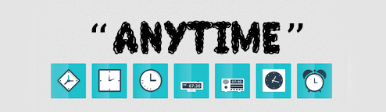
Objectives
Open source

Slide 12



Objectives
Explore
manage

Slide 13



Limits
Operates on
requires
No security
Android os
Internet
connection
Inappropriate
information

Slide 14
Progress Report 2
Work items

Slide 15
Work items
Project
plan
SRS software requirement specification]
SDD [software design document]
Test plan
Traceability record
Test record

Slide 16
Project Plan
3
5
SRS software requirement specification]
Project
plan
10
25
SDD [software design document]
implementation
5
2
Traceability record
Test plan
Test record

Slide 17
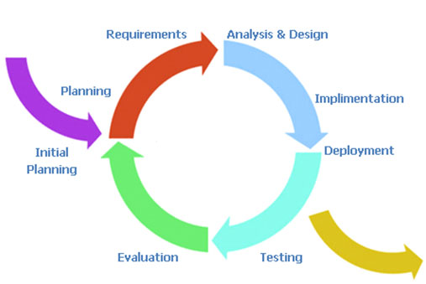
Project Plan

Slide 18

Repository

Slide 19

SRS Document
Use Case
User Requirement Specification (URS) and Description
Activity Diagram
System Requirement Specification (SRS)

Slide 20


Requirement Analysis
feature
Use case
urs
srs
Activity
diagram
Urs
description

Slide 21

Use case

Slide 22

Use case

Slide 23
Requirement Analysis
84 URS
Web User requirement specification : 38 URSs.
Mobile User requirement specification : 46 URSs.
242 sRS
Web system requirement specification : 106 SRSs.
Mobile system requirement specification : 136 SRSs.

Slide 24


URS & URS Description
M-URS-20: The user shops that exist
in database by choosing a category.
Input
output

Slide 25
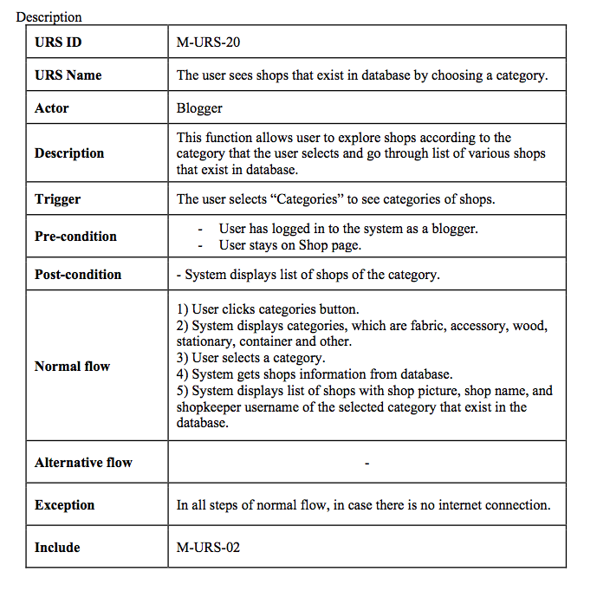
M-urs-20 description

Slide 26
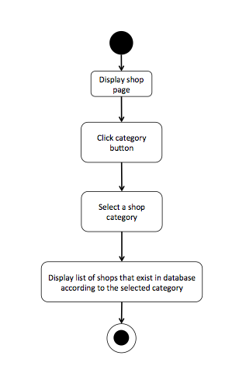
Activity diagram
M-AD-20

Slide 27
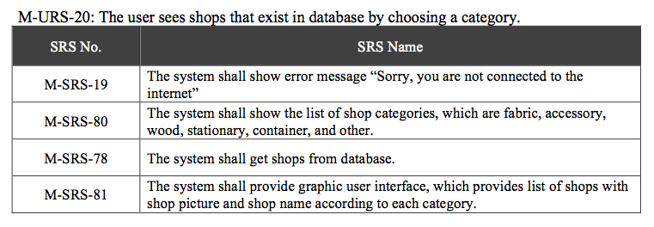
SRS

Slide 28
Software Design
System Architecture
Class Diagram and Description
Sequence Diagram
Database Design
User Interface Design
Traceability Record

Slide 29





Architecture
Explore
Visitors
HanDIYcraft
Google Maps API
Manage
Bloggers
Shopkeepers
Facebook
request
response
JSON
HanDIYcraft
request
response
My SQL
JSON
Server

Slide 30
Class
diagram

Slide 31
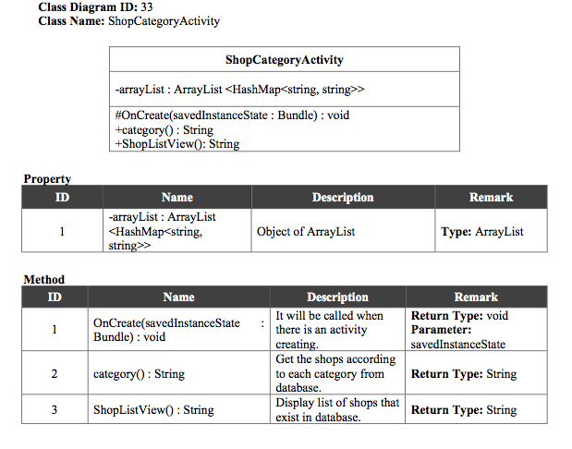
Class Diagram Description

Slide 32

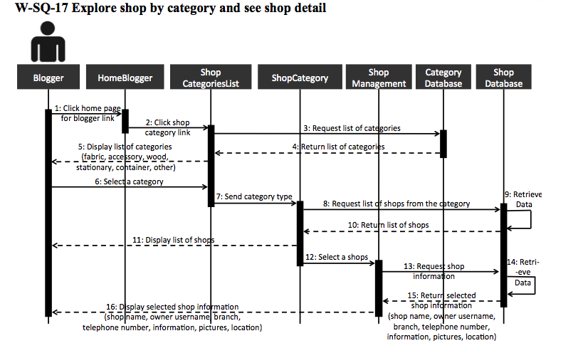
Sequence diagram

Slide 33

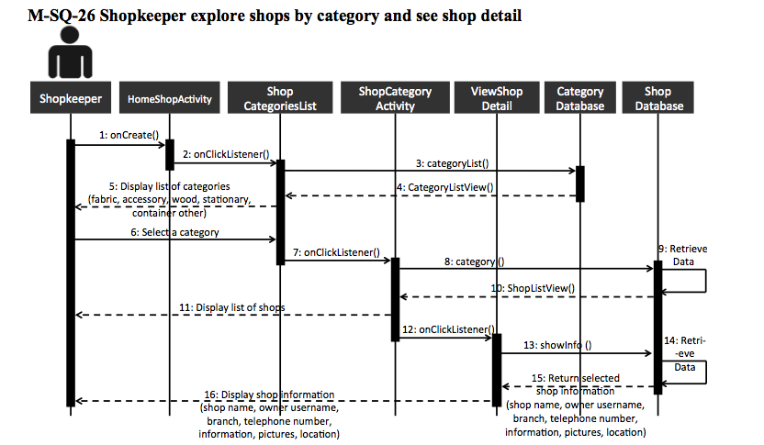
Sequence diagram

Slide 34
Database design

Slide 35
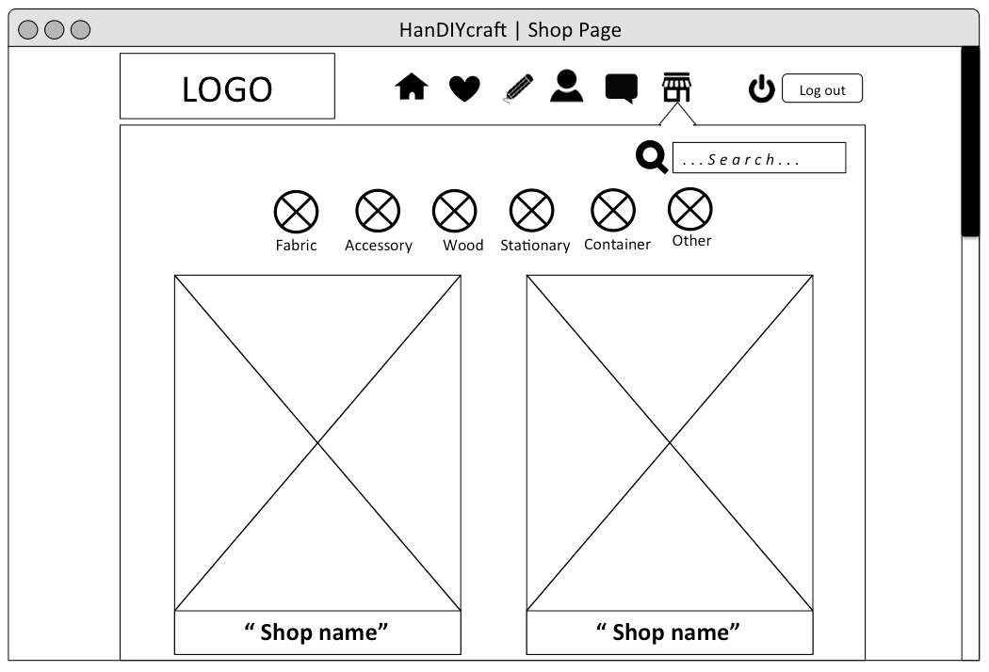
User interface design

Slide 36
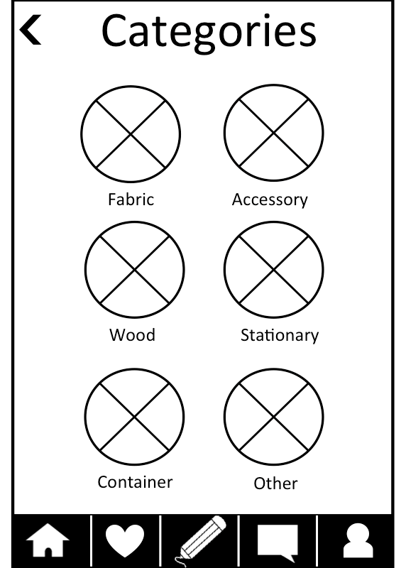
User interface design

Slide 37
Software Construction
SRS [software requirement specification]
SDD [software design document]
HanDIYcraft
HanDIYcraft

Slide 38

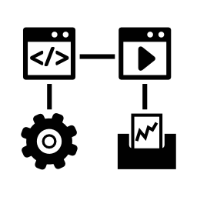

Software Testing
Test Plan
Unit Testing
System Testing
Test Record
Input
Output
Input
Output

Slide 39
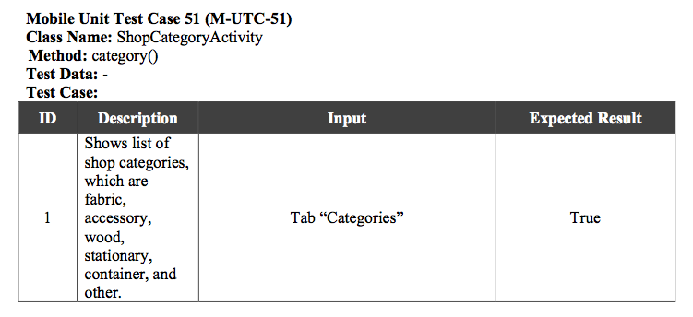
Unit test case

Slide 40
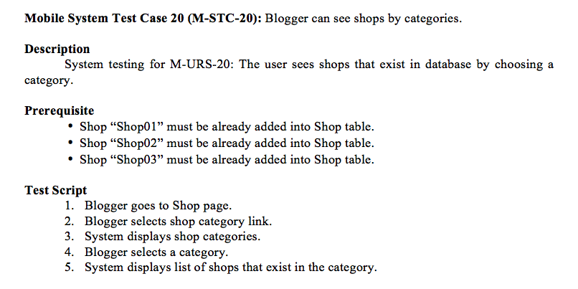
System test case

Slide 41
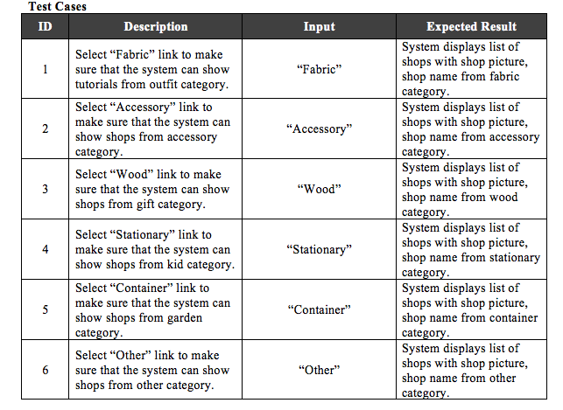
System Test Case

Slide 42
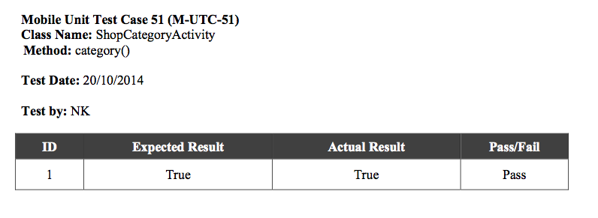
unit Test record

Slide 43
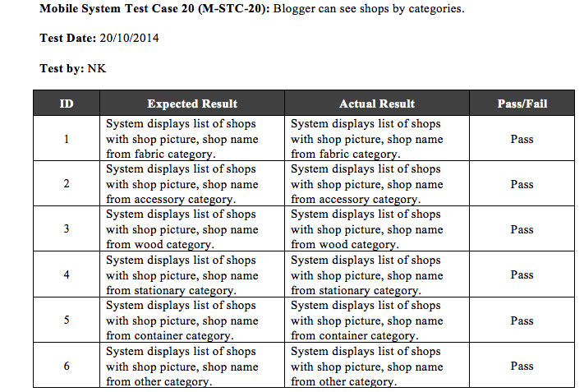
System Test record

Slide 44
Software
Demo

Slide 45

Software Demo

Slide 46
Mistakes and
Problems

Slide 47
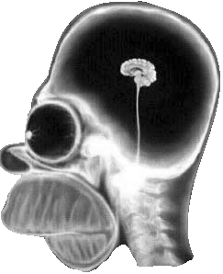

Mistakes&Problems
Carelessness and Less technical knowledge

Slide 48

Mistakes&Problems
Time Management

Slide 49
Mistakes&Problems
“Change”
Web
Mobile
shop
map
communication

Slide 50

Mistakes&Problems
We couldn’t combine all the code on time

Slide 51
Mistakes&Problems
No actual device to test

Slide 52
Progress 3 (Show Pro)
Plan

Slide 53
Software
Version 0.3
Feature 3
Shop
management
(Web)
Feature 6
Notification
management
(Mobile, Web)
Feature 4
Map management
(Mobile, Web)

Slide 54

Document
Version 3.0
Project Plan document
SRS document
SDD document
Test Plan document
Test Record document
Traceability Record document

Slide 55
Q&A

